Slide 1
CS152 Section 4
Virtual Memory and Lab 2

Slide 2
Agenda
Exam logistics
Midterm 1 review during next discussion section
Suggest topics to cover in more detail
Virtual Memory
Lab 2 Overview

Slide 3
Midterm 1 Format
80-minute timed exam during normal lecture slot (Mon March 1)
For significant time zone differences, contact instructors to schedule alternative exam times
DSP accommodations will be handled similarly
Exam will be released on bCourses at 9:10 AM
Look under Quizzes section
Upload answers to Gradescope (not bCourses) by 10:30 AM
Separate PDF files for each question
Practice exam will be posted next week on bCourses in an identical format
Exams should be completed by hand
Ask questions in private posts to instructors on Piazza
Zoom chat will be disabled
Do not discuss the exam with other students until everyone has finished taking it

Slide 4
Midterm 1 Remote Proctoring
Join Zoom session with webcam enabled during exam
Camera pointed towards workspace (paper/hands)
Text should not be readable on video, try to cover your answers
Instructors will be monitoring through gallery view
Everyone will be asked to show student ID card and faces at one point
Instructors will add people to breakout rooms one at a time
Turn on sound so notifications aren’t missed
Contact instructors if no functional webcam is available or if you have other concerns

Slide 5
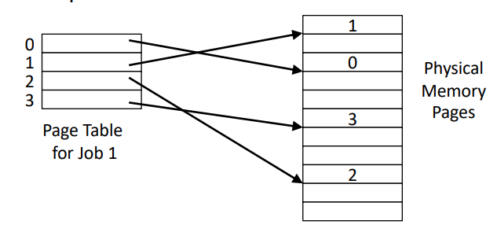
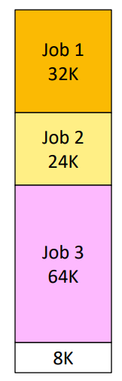
Memory Hierarchy - Paging vs Segmentation
 | Page | Segment
Replace a block | Easy (fixed size) | Difficult (variable size, hard to find in main memory)
Inefficiency | Internal | External
Efficiency in disk traffic | Yes (adjust page size to balance access time and transfer time) | Not always (bad when the segment is small)

Slide 6
Linear vs Hierarchical Page Tables
Consider 4 GiB (32-bit) of addressable virtual memory, 4 KiB pages, 4-byte PTEs
How many bits in the page offset?
How many bits in the page number?
How many pages?
Consider a linear page table for a process with only 1 page mapped to physical memory (paged in)
How many valid PTEs?
Total size of page table?
Consider a 2-level page table for a process with only 1 page mapped to physical memory (paged in). Assume that VPN bits are split equally between the two levels.
How many valid PTEs?
Total size of page table?

Slide 7
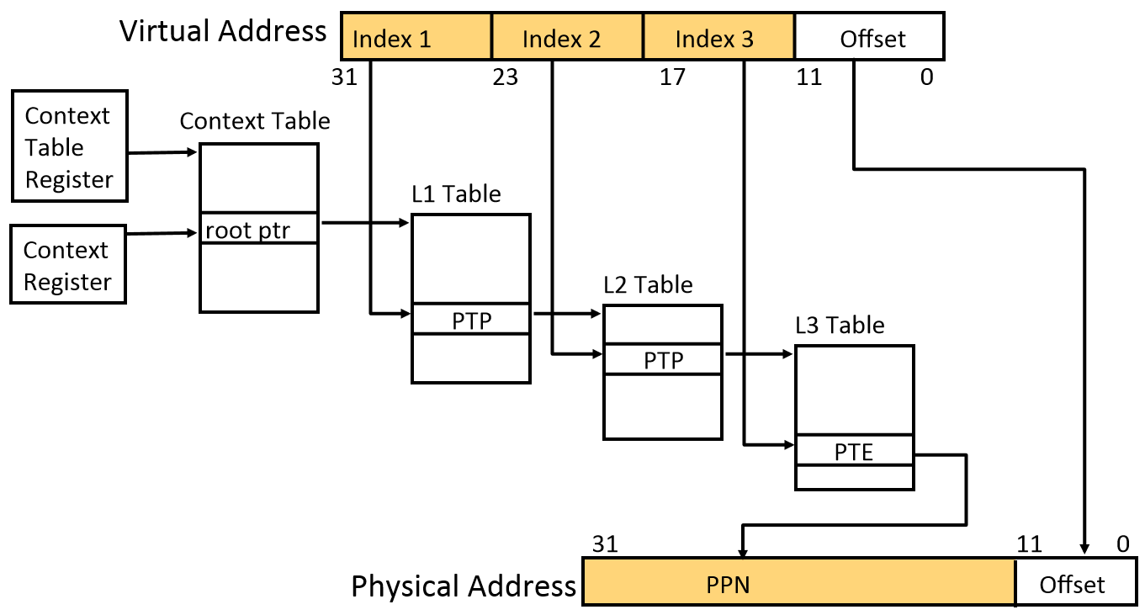
Memory Hierarchy - Virtual Memory
Page Table Walk
Expensive
Software/Hardware
Are virtual and physical addresses necessarily the same width?
Can an architecture support multiple page sizes simultaneously?
Advantages and disadvantages of superpages?

Slide 8
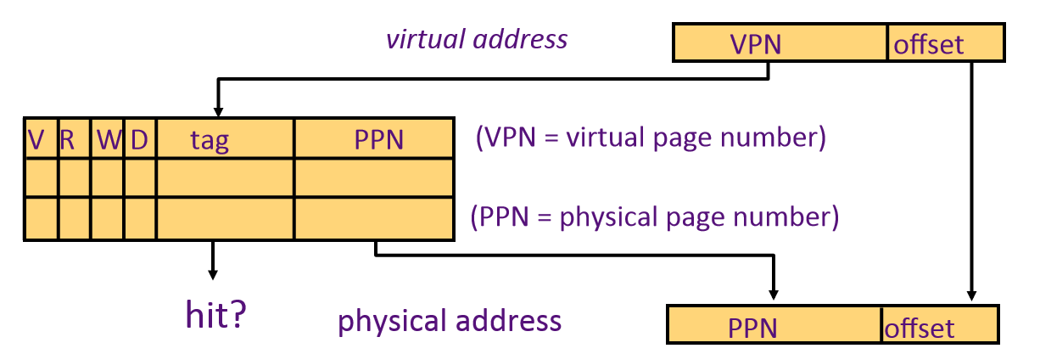
Memory Hierarchy - TLBs
TLB
Speed up address translation by caching PTEs
Typically fully associative
TLB miss is distinct from a page fault!
On ALL accesses to a virtual address
Check for tag match in TLB
If no match:
Perform PTW
If no valid PTE (not paged in), page fault
Check protection bits:
If fail, page fault
Refer to online Appendix L of textbook for exhaustive treatment on TLB design

Slide 9
Memory Hierarchy - Page Tables
What are the advantages of a hierarchical page table?
Disadvantages?
What’s in a PTP? (Page table pointer)
What’s in a PTE? (Page table entry)
What manages the page tables?
Should page tables reside in cache? Where?
When should PTEs enter the TLB?
Should page tables reside in cache? What are the advantages/disadvantages?
What if a PTE is modified in the page table while currently present in the TLB?
What if that PTE is in multiple TLBs (i.e., different cores)?

Slide 10
Memory Hierarchy - Page Fault Handler
Page faults represent a variety of causes:
Pages that were swapped out to secondary storage (disk)
Pages that are part of the legitimate address space but not yet committed
Copy-on-write with shared pages or zero-filled pages
Emulating accessed/dirty bits in PTEs without hardware support
Segfault
Most page faults that occur are not errors!
Page faults must be restartable exceptions

Slide 11
Memory Hierarchy - Multi-level Page Table
Assume: 8-bit virtual addresses, 32-bit words, 16-byte pages, two-level page table, LRU 4-entry TLB
At the beginning, the TLB is empty and the free pages list contains 0x9, 0x5, 0xA, 0x7, 0x1, 0x3, 0xB, 0xD, 0xE, and 0xF in that order
How many bytes of virtual memory are addressable?
How many bytes of physical memory are addressable? Assume a PTE is PPN + valid bit
Why might DRAM size > virtual address space size be useful?

Slide 12
Memory Hierarchy - Multi-level Page Table
Offset bits:
VPN bits:
Index1 bits:
Index2 bits:
offset =
index2 =
index1 =

Slide 13
Complete the Tables
Addr | Contents
0x00 | 0x06
0x04 | 0x04
0x08 | 0x02
0x0C
0x10
0x14
0x18
0x1C
0x20 | 0x08
0x24
0x28
0x2C
0x30
0x34
0x38
0x3C
0x40
0x44
0x48 | 0x12
0x4C | 0x11
0x50
0x54
0x58
0x5C
0x60
0x64 | 0x13
0x68
0x6C
Free pages: 0x9, 0x5, 0xA, 0x7, 0x1, 0x3, 0xB, 0xD, 0xE, 0xF
Virtual Address | Index1 | Index2 | TLB hit/miss | Page hit/ Page fault | Physical Address
0x68
0x14
0x6C
0x90
0x74
0xE4
0x18
0xD0
TLB
VPN
PPN

Slide 14
Lab 2
Focuses on design of memory hierarchies using realistic SoC implementations
Directed problem: Matrix transpose case study
Open-ended problems:
Reverse-engineer a memory system using micro-benchmarks
Design your own hardware prefetcher
Design your own replacement policy and victim cache

Slide 15
Fair Warning
Expect to spend a significant fraction of time on RTL simulations
Some interesting memory behaviors only manifest over longer time scales
~4.5 kHz simulator (varies by design complexity)
0.5-3 million cycles for a “short” program (2 to 10 minutes)
Up to 10 million cycles for a few benchmarks (bfs, ccbench)
Potentially long debug cycle for some open-ended problems
Can run parallel simulations in some cases (make -j N)
Budget your time appropriately - start early!

Slide 16
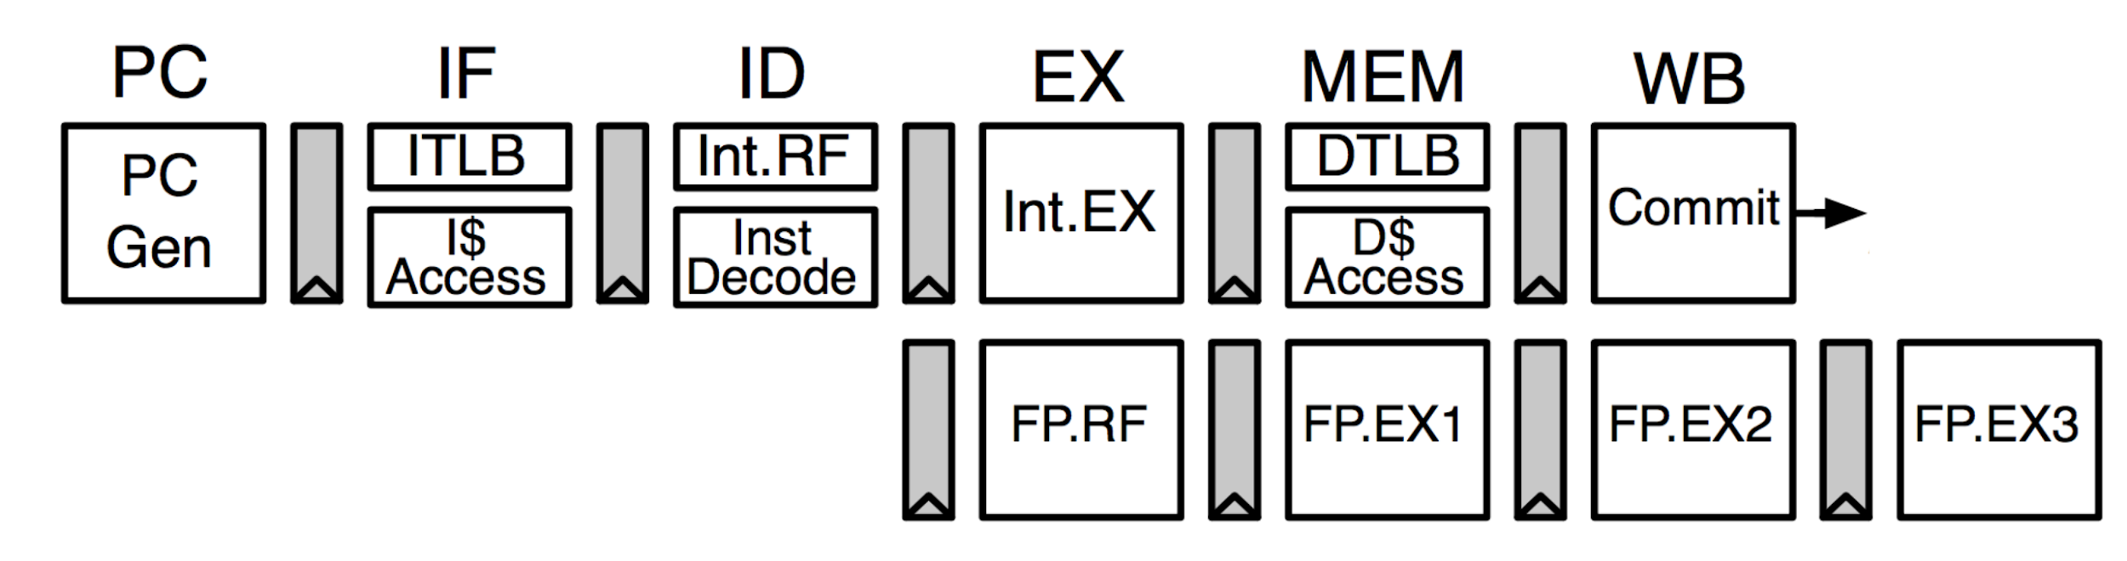
Rocket
Single-issue in-order RV64IMAFDC core
Extensively optimized for efficient ASIC implementation (1.6 GHz in 28nm)
Minimize high-fanout stall signals
Restructure pipeline logic to cope with long clock-to-Q delays of compiler-generated SRAMs
Details in background section of Lab 2 document
Implements privileged ISA

Slide 17
Open-Ended Problem 1
Goal: Infer memory system parameters by writing micro-benchmarks and measuring execution latency
Provided with an obfuscated “mystery” design to reverse-engineer
Select a few to determine:
L1 D cache latency*
L1 D cache size*
L1 D cache associativity
L1 D cache replacement policy
L1 I cache size
L1 I cache associativity
L1 I replacement policy
L1 I TLB reach
L1 D TLB reach
L2 TLB reach
L2 TLB hit latency
L2 cache latency*
L2 cache size*
DRAM latency*
DRAM page policy
Aggregate DRAM page size
Number of DRAM ranks
DRAM CAS/RCD/RP timings

Slide 18
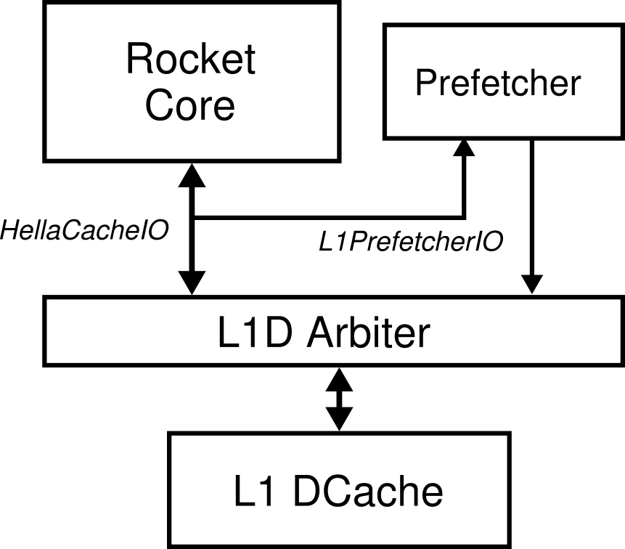
Open-Ended Problem 2
Goal: Build a hardware prefetcher for Rocket’s L1D
Snoops on core/L1D interface and injects prefetch requests
Non-blocking data cache
Two implementation options: Chisel RTL or C++ model

Slide 19
Open-Ended Problem 3
Goal: Design a cache replacement policy and victim cache that performs better than default random replacement
Implement in a RISC-V ISA simulator extended with a cache model
Evaluate on a subset of SPEC CPU2006

Slide 20
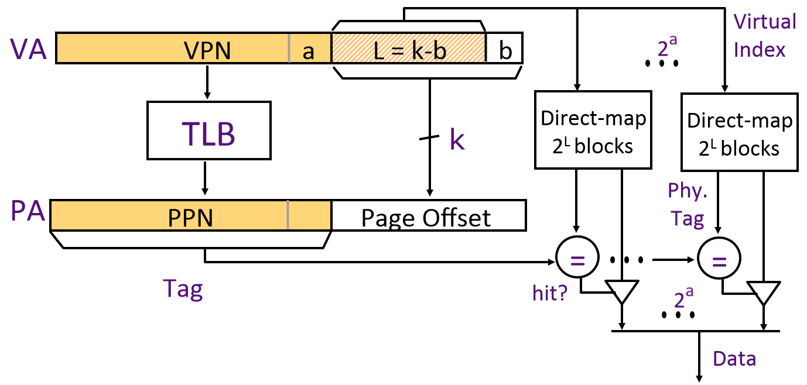
Memory Hierarchy - VIPT address aliasing
Aliasing
(number of sets * cache line size) > page size
VA1 and VA2 are different at [a] → point to different sets in cache
VA1 and VA2 point to the same PPN
Leads to multiple copies of same data in cache → coherence problem

Slide 21
Memory Hierarchy - VIPT address aliasing
Exercise 2

